Slide 1



Click to Open

Slide 2


Page 1
Page 2

Slide 3
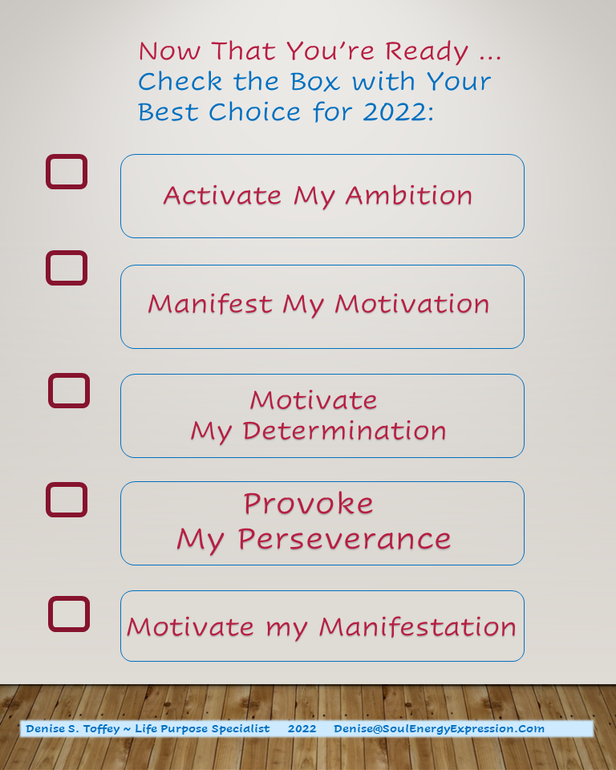
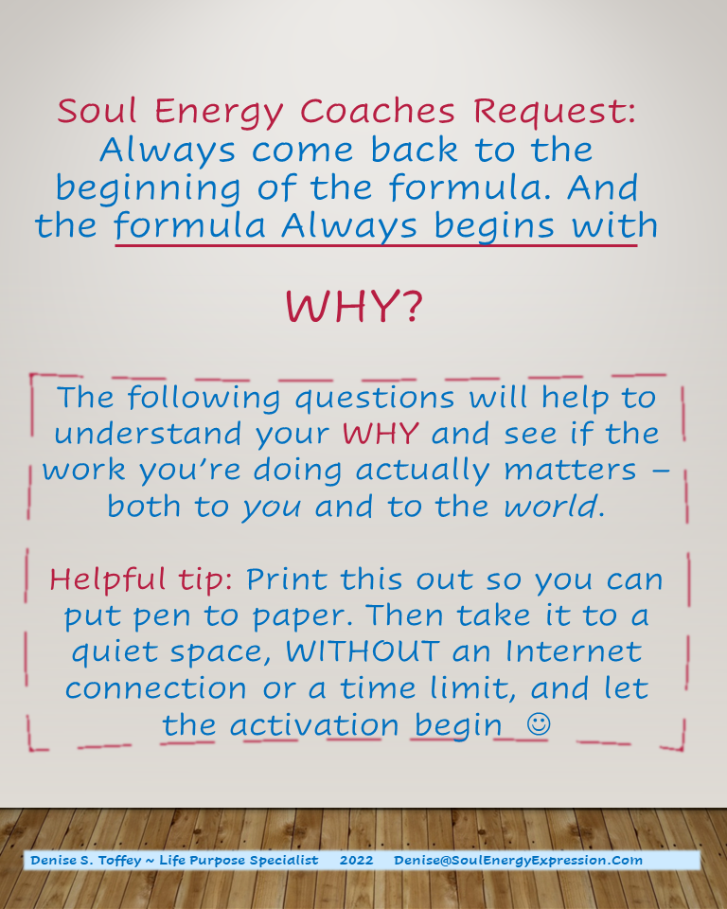
Page 3
Page 4

Slide 4
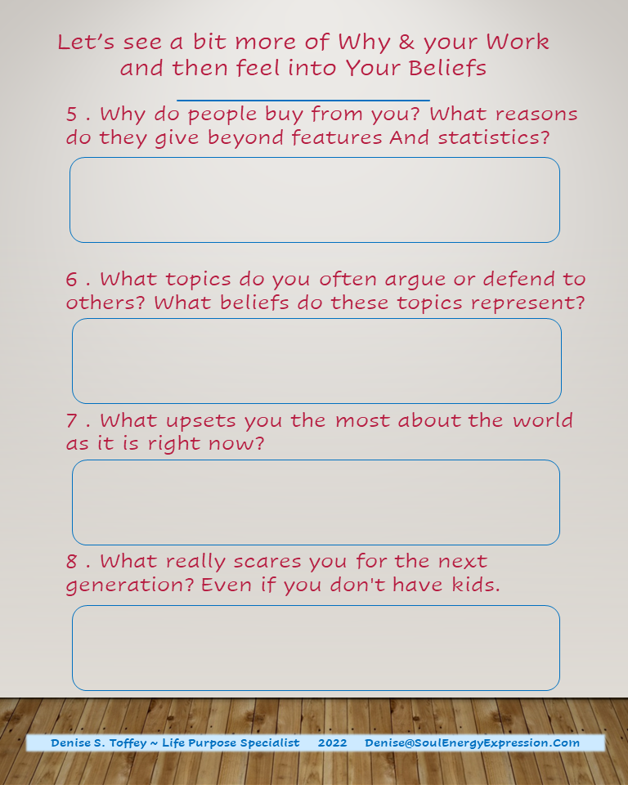
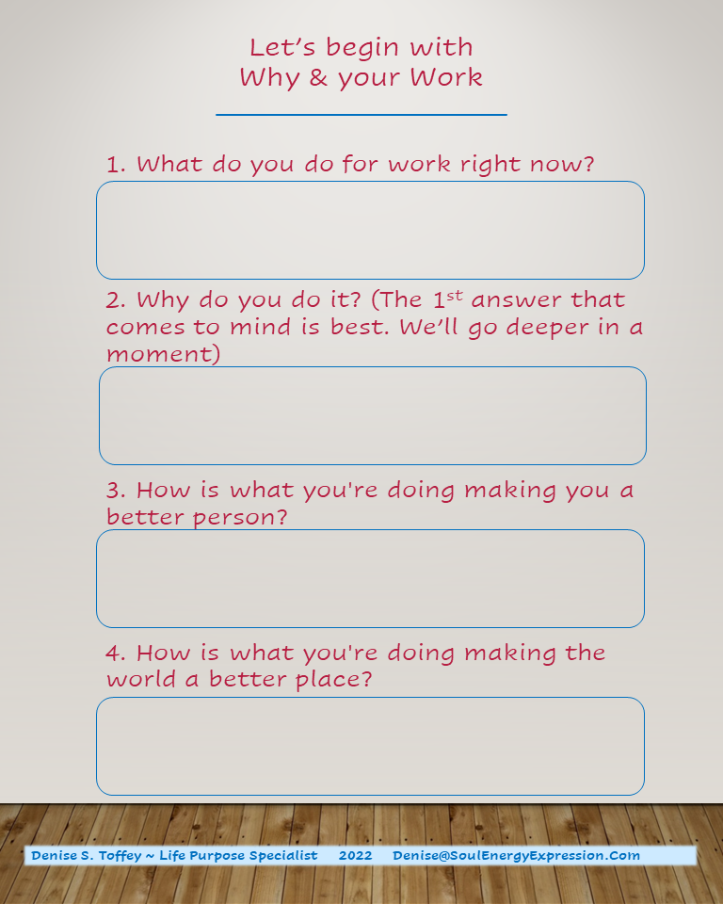
Page 5
Page 6

Slide 5
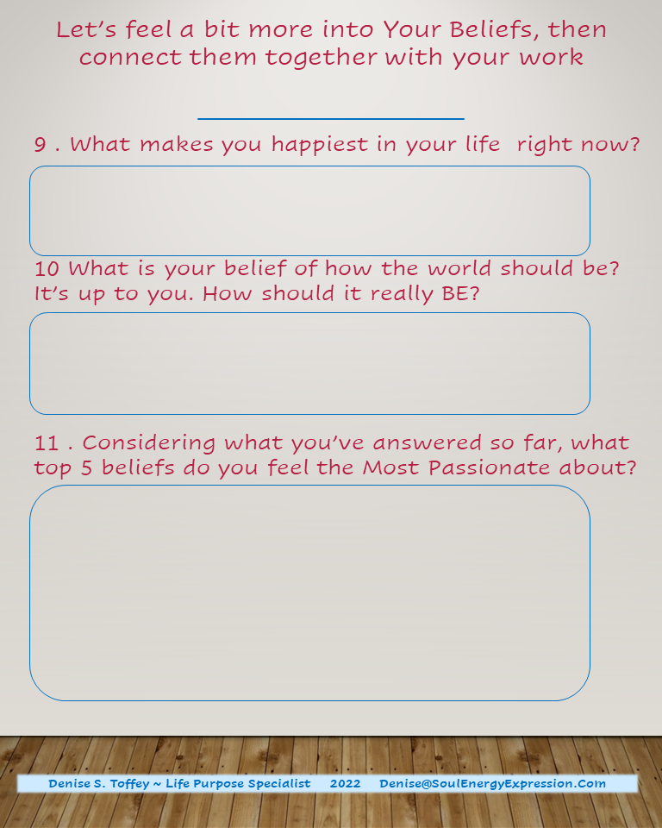

Page 7
Page 8

Slide 6
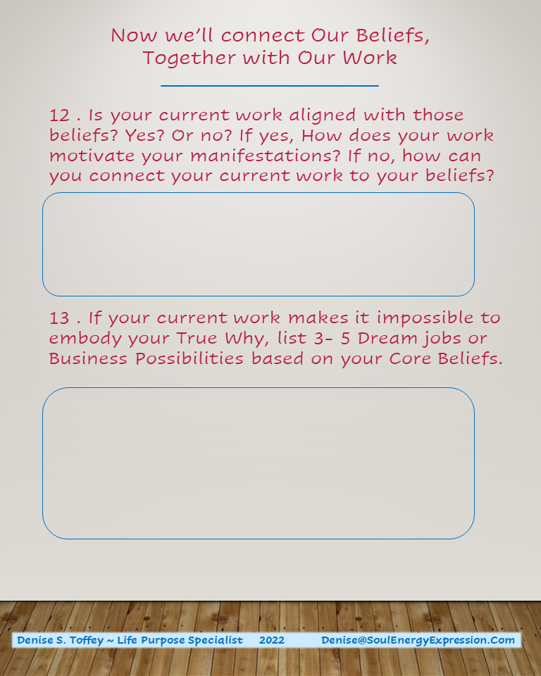
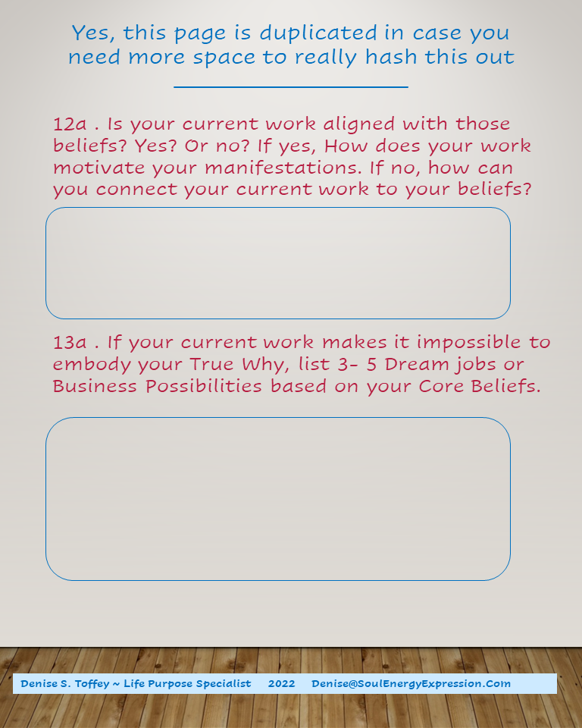
Page 9
Page 10

Slide 7
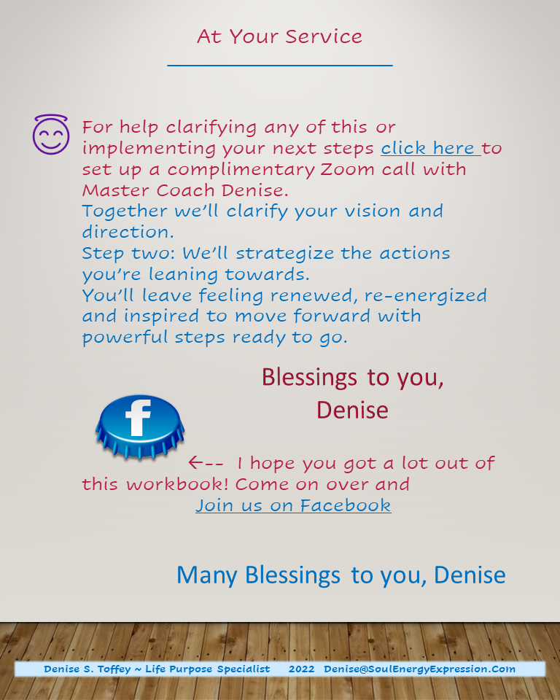
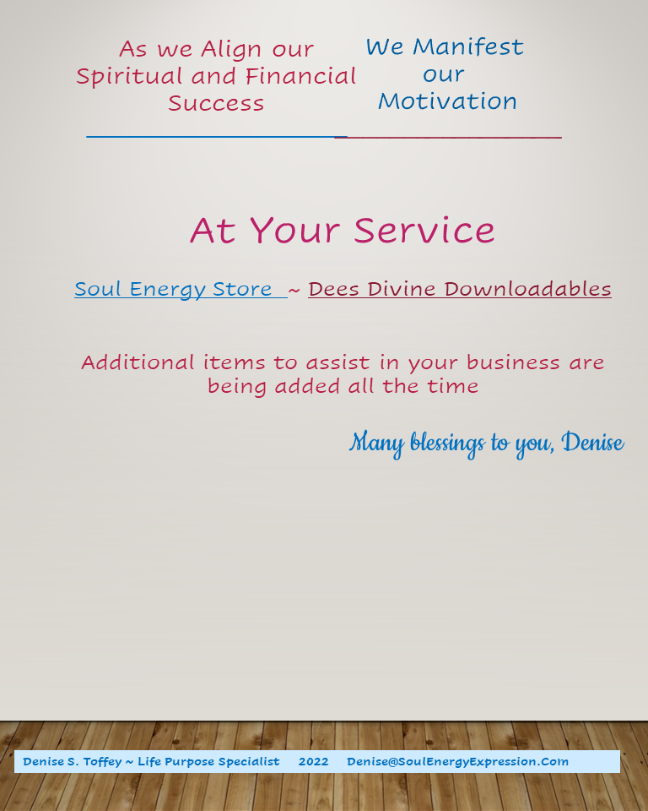
Page 11
Page 12

Slide 8

Blessings to you, Denise
SoulEnergyExpression.Com
Denise S. Toffey ~ Life Purpose Specialist 2022 Denise@SoulEnergyExpression.Com

